Slide 1

SUBJECT NAME: Programming in Java SUBJECT CODE: SITA1301

Slide 2
UNIT 1: INTRODUCTION TO JAVA
Classes and Objects – Class Fundamentals – Declaring Objects – Methods – Constructors – Garbage Collection.
Inheritance – Basics – Using Super – Method Overriding – Abstract Classes – Using final with inheritance. String Handling –String class – String buffer class.
Notes:
JHKJLSDHFILPS[ROWEIT[N0EARIT9 8AER098E5R09 N79N0E57T09E

Slide 3
CLASSES AND OBJECTS
A class is nothing but a blueprint or a template for creating different objects which defines its properties and behaviors.
Java class objects exhibit the properties and behaviors defined by its class
An object is an instance of a class
Object in Java:
An entity that has state and behavior is known as an object e.g. chair, bike, marker, pen, table, car etc.

Slide 4
CLASS
Class is a collection of data members and member functions.
Data members are nothing but simply variables that we declare inside the class so it called data member of that particular class.
Member functions are the function or you can say methods which we declare inside the class so it called member function of that particular class.

Slide 5
Syntax of class
class classname // class sample
{
type instance-variable1;// int a ;
type instance-variable2;// int b;
type methodname1(parameter-list)// void sum(int a, int b)
{ // body of method
}
type methodname2(parameter-list)// void multiply(int a, int b)
{ // body of method
} }

Slide 6
OBJECTS IN JAVA
How to declare object of class in java?
Syntax of object:
classname objectname; \\ declaration of object.
objectname = new classname(); \\ allocate memory to object (define object).
or we can directly define object like this
classname objectname = new classname();

Slide 7
Example : Class and Objects
class TestStudent2
{
public static void main(String args[])
{
Student s1=new Student();
s1.id=505;
s1.name=“kumar"; System.out.println(s1.id+""+s1.name);
//printing members with a white space
}
}
class Student
{
int id;
String name;
}

Slide 8
To Access data member or methods of class
To access data member or methods of class we have to write objectname
Syntax:
Accessing data member of the class: objectname.datamember name;
Accessing methods of the class: objectname.method name();
So for accessing data of the class: we have to use (.) dot operator.

Slide 9
METHODS IN JAVA
A method is a block of code or collection of statements or a set of code grouped together to perform a certain task or operation.
It is used to achieve the reusability of code.
We write a method once and use it many times.
We do not require to write code again and again.
It also provides the easy modification and readability of code, just by adding or removing a chunk of code. The method is executed only when we call or invoke it.
The most important method in Java is the main() method.

Slide 10
METHODS IN JAVA
Method describe behavior of an object. A method is a collection of statements that are group together to perform an operation.
Syntax :
Modifier return-type methodName(parameter-list)
{
//body of method
}

Slide 11
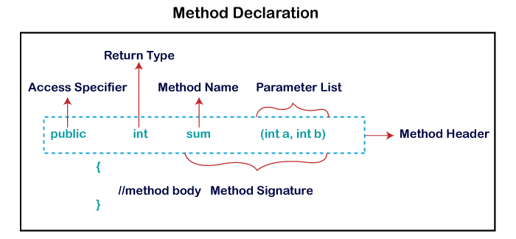
METHOD DECLARATION

Slide 12
How To Name A Method
Single-word method name: sum(), area()
Multi-word method name: areaOfCircle(), stringComparision()
It is also possible that a method has the same name as another method name in the same class, it is known as method overloading.

Slide 13
TYPES OF METHODS IN JAVA
Two types of methods in Java:
Predefined Method- length(), equals(), compareTo(), sqrt()
User-defined Method- findEvenOdd, getData()
//user defined method
public static void findEvenOdd(int num)
{
//method body
if(num%2==0)
System.out.println(num+" is even");
else
System.out.println(num+" is odd");
}

Slide 14
CONSTRUCTORS:
*Constructor in java is a special type of method that is used to initialize the object.
* Java constructor is invoked at the time of object creation.
* It constructs the values i.e. provides data for the object.
*Constructor in Java cannot be abstract, static, final or synchronized.
Rules for creating java constructor
There are basically two rules defined for the constructor
1. Constructor name must be same as its class name.
2. Constructor must have no explicit return type.

Slide 15
Types of Java constructors
* Default constructor (no-argument constructor)
* Parameterized constructor
* Constructor overloading
* There is no copy constructor in Java
Default Constructor
If any constructor not defined in class, java generates one constructor at the time of object creation by default. This constructor is known as default constructor.
Syntax of default constructor:
<class_name>()
{
}
Rule: If there is no constructor in a class, compiler automatically creates a default constructor.

Slide 16
Example of default constructor
class Bike
{
Bike()
{
}
public static void main(String args[])
{
Bike b=new Bike();
}
}

Slide 17
No-argument constructor
Constructor with no arguments is known as no-argument constructor.
Example:
class Demo
{
public Demo()
{
System.out.println("This is a no argument constructor");
}
}

Slide 18
Parameterized constructor
A constructor that has parameters is known as parameterized constructor.
Parameterized constructor is used to provide different values to the distinct objects.
Example:
class Student4
{
int id;
String name;
Student4(int i, String n)
{
id = i;
name = n;
}
void display()
{
System.out.println(id+" "+name);
}
public static void main(String args[])
{
Student4 s1 = new Student4(111,"Karan");
Student4 s2 = new Student4(222,"Aryan");
s1.display();
s2.display();
}
}

Slide 19
Constructor Overloading
* A constructor is just like a method but without return type.
* It can also be overloaded like Java methods.
* Constructor overloading in Java is a technique of having more than one constructor with different parameter lists.
* They are arranged in a way that each constructor performs a different task.
* They are differentiated by the compiler by the number of parameters in the list and their types
.

Slide 20
Example :Constructor Overloading
class Student5{
int id;
String name;
int age;
Student5(int i,String n){
id = i;
name = n;
}
Student5(int i,String n,int a){
id = i;
name = n;
age=a;
}
void display()
{
System.out.println(id+" "+name+" "+age);}
public static void main(String args[])
{
Student5 s1 = new Student5(111,"Karan");
Student5 s2 = new Student5(222,"Aryan",25);
s1.display();
s2.display();
}
}

Slide 21
Difference between constructor and method in Java
.
Java Constructor | Java Method
A constructor is used to initialize the state of an object. | A method is used to expose the behavior of an object.
A constructor must not have a return type. | A method must have a return type.
The constructor is invoked implicitly. | The method is invoked explicitly.
The Java compiler provides a default constructor if you don't have any constructor in a class. | The method is not provided by the compiler in any case.
The constructor name must be same as the class name. | The method name may or may not be same as the class name.

Slide 22
Java Copy Constructor
There is no copy constructor in Java. However, we can copy the values from one object to another like copy constructor in C++.
There are many ways to copy the values of one object into another in Java. They are:
By constructor
By assigning the values of one object into another
By clone() method of Object class
.

Slide 23
Example :In this example, we are going to copy the values of one object into another using Java constructor.
class Student6
{
int id;
String name;
Student6( int i, String n)
{
id = i;
name = n;
}
Student6(Student6 s){
id = s.id;
name =s.name;
}
void display(){System.out.println(id+" "+name);
}
public static void main(String args[]){
Student6 s1 = new Student6(111,"Karan");
Student6 s2 = new Student6(s1);
s1.display();
s2.display();
}
}

Slide 24
Scanner class
The Scanner class is used to get user input, and it is found in the java. util package.
To use the Scanner class, create an object of the class and use any of the available methods found in the Scanner class documentation.nextLine() method, which is used to read Strings:
.
nextBoolean() | Reads a boolean value from the user
nextByte() | Reads a byte value from the user
nextDouble() | Reads a double value from the user
nextFloat() | Reads a float value from the user
nextInt() | Reads a int value from the user
nextLine() | Reads a String value from the user
nextLong() | Reads a long value from the user
nextShort() | Reads a short value from the user

Slide 25
Scanner input = new Scanner(System.in);
num = input.nextInt();
if ( num % 2 == 0 )
System.out.println("Entered number is even");
else
System.out.println("Entered number is odd");
}
}
Scanner Example
//Scanner :input from user
import java.util.Scanner;
class ScannerEvenOdd
{
public static void main(String args[])
{
int num;
System.out.println("Enter an Integer number:");

Slide 26
Inheritance:
Inheritance in java is a mechanism in which one object acquires all the properties and behaviors of parent object.
Why use inheritance in java
For Method Overriding (so runtime polymorphism can be achieved).
For Code Reusability.
Syntax of Java Inheritance
class Subclass-name extends Superclass-name
{
//methods and fields
}

Slide 27
Types of inheritance
Single Inheritance
Multiple Inheritance (Through Interface)
Multilevel Inheritance
Hierarchical Inheritance
Hybrid Inheritance (Through Interface)

Slide 28
Single Inheritance:
Single Inheritance is the simple inheritance of all, When a class extends another class(Only one class) then it called as Single inheritance.

Slide 29
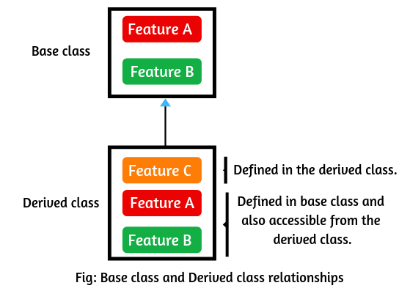
Realationship between Parent and Child class

Slide 30
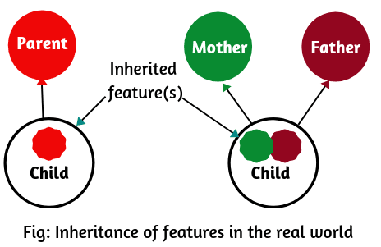
Realtime Example of Inheritance in Java
In the real world, a child inherits the features of its parents such as beauty of mother and intelligence of father as shown in the below figure.

Slide 31

Realtime Example of Inheritance in Java

Slide 32
Example
class ClassA
{
public void dispA()
{
System.out.println("disp() method of ClassA");
}
}
public class ClassB extends ClassA
{
public void dispB()
{
System.out.println("disp() method of ClassB");
} }
public static void main(String args[])
{
ClassB b = new ClassB();
b.dispA();
b.dispB();
}
}

Slide 33
Multiple Inheritance in Java
Multiple Inheritance is nothing but one class extending more than one class. Multiple Inheritance is basically not supported by many Object Oriented Programming languages such as Java, Small Talk, C# etc. But using interfaces multiple inheritance is achieved in Java.

Slide 34
Multilevel Inheritance
In Multilevel Inheritance a derived class will be inheriting a parent class and as well as the derived class act as the parent class to other class.

Slide 35
MultiLevel Inheritance Example
class ClassA
{
public void dispA()
{
System.out.println("disp() method of ClassA");
} }
class ClassB extends ClassA
{
public void dispB()
{
System.out.println("disp() method of ClassB");
} }
public class MultilevelClassC extends ClassB
{
public void dispC()
{
System.out.println("disp() method of ClassC");
}
public static void main(String args[])
{
MultilevelClassC c = new MultilevelClassC();
c.dispA();
c.dispB();
c.dispC();
} }

Slide 36
Hierarchical Inheritance
In Hierarchical inheritance one parent class will be inherited by many sub classes.

Slide 37
Example:
public class ClassA
{
public void dispA()
{
System.out.println("disp() method of ClassA");
} }
public class ClassB extends ClassA
{
public void dispB()
{
System.out.println("disp() method of ClassB");
} }
public class ClassC extends ClassA
{
public void dispC()
{
System.out.println("disp() method of ClassC");
} }
public class ClassD extends ClassA
{
public void dispD()
{
System.out.println("disp() method of ClassD");
} }

Slide 38
public class HierarchicalInheritanceTest
{
public static void main(String args[])
{
ClassB b = new ClassB();
b.dispB();
b.dispA();
ClassC c = new ClassC();
c.dispC();
c.dispA();
ClassD d = new ClassD();
d.dispD();
d.dispA();
}
}

Slide 39
Hybrid Inheritance in Java
Hybrid Inheritance is the combination of both Single and Multiple Inheritance.

Slide 40
Java static variable
If you declare any variable as static, it is known as a static variable.
.
The static variable can be used to refer to the common property of all objects (which is not unique for each object), for example, the company name of employees, college name of students, etc.
The static variable gets memory only once in the class area at the time of class loading.
Advantages of static variable
It makes your program memory efficient (i.e., it saves memory).

Slide 41
Java static method
. If you apply static keyword with any method, it is known as static method.
A static method belongs to the class rather than the object of a class.
A static method can be invoked without the need for creating an instance of a class.
A static method can access static data member and can change the value of it.
Restrictions for the static method
There are two main restrictions for the static method. They are:
The static method can not use non static data member or call non-static method directly.
this and super cannot be used in static context.

Slide 42
Java static-Program1
class staticA{
static int a=40;//non static
public static void main(String args[]){
System.out.println(a);
}
}

Slide 43
Java static-Program2
class A{
static int num1=10;
static int num2=5;
}
class SingleInheritanceAdd extends A{
public static void main(String[] args){
int num3=2;
int result=num1+num2+num3;
System.out.println("Result of child class is "+result);
}
}

Slide 44
Method Overloading
A Class has multiple methods of the same name with different parameters is called Method overloading.
This will allow one function call to perform different tasks depending on method parameters.
Method overloading is also known as Static Polymorphism.
Overload the method in Java, changing number of arguments and changing the data type
Only based on return type, overloading is not possible in Java,
Method overloading increases the readability and reliability of the program.

Slide 45
Method Overloading
Example: changing number of arguments
class MethodOverloadingExample{
public void add(int num1,int num2){
int result1=num1+num2;
System.out.println("Result of first method is "+result1);
}
public void add(int num1,int num2,int num3){
int result2=num1+num2+num3;
System.out.println("Result of overloaded method is "+result2);
}
}
class MainMethodOverloading{
public static void main(String[] args){
MethodOverloadingExample obj=new MethodOverloadingExample();
obj.add(10,5);
obj.add(1,5,2);
}
}

Slide 46
Method Overloading
Example: changing the data type
class MethodOverloadingExample{
public void overloadingMethod(int num,String string){
System.out.println("Method with integer and String inputs is called.");
}
public void overloadingMethod(int num1,float num2){
System.out.println("Method with integer and float inputs is called.");
}
}
class MethodOverloadingWithDifferentDataTypes{
public static void main(String[] args){
MethodOverloadingExample obj=new MethodOverloadingExample();
obj.overloadingMethod(10,"Overloading");
obj.overloadingMethod(1,5.3f);
}
}

Slide 47
Method Overriding
If subclass (child class) has the same method as declared in the parent class, it is known as method overriding in java.
It allows a subclass or child class to provide a specific implementation of a method that is already provided by one of its superclasses or parent classes
Usage of Java Method Overriding
Method overriding is used to provide specific implementation of a method that is already provided by its super class.
Method overriding is used for runtime polymorphism

Slide 48
MainMethodOverriding
Method Overriding
Method Overriding
Example:
class MethodOverridingExample{
public void add(int num1,int num2){
int result1=num1+num2;
System.out.println("Result of parent class method is "+result1);
}
}
class OverriddenMethod{
public void add(int num1,int num2){
int result2=num1-num2;
System.out.println("Result of overridden method is "+result2);
}
}
class MainMethodOverriding{
public static void main(String[] args){
MethodOverridingExample obj1= new MethodOverridingExample();
obj1.add(7,5);
OverriddenMethod obj2=new OverriddenMethod();
obj2.add(7,5);
}
}

Slide 49
Super Keyword:
The super keyword in java is a reference variable which is used to refer immediate parent class object.
It allows users to access members of a superclass in a subclass.
Syntax:
super. variablename;
super . <method-name>();
Usage of java super Keyword
super can be used to refer immediate parent class instance variable.
super can be used to invoke immediate parent class method.
super() can be used to invoke immediate parent class constructor.

Slide 50
Super Keyword:
Super keyword is used inside a sub-class method definition to call a method defined in the super class.
Private methods of the super-class cannot be called.
Only public and protected methods can be called by the super keyword.
It is also used by class constructors to invoke constructors of its parent class

Slide 51
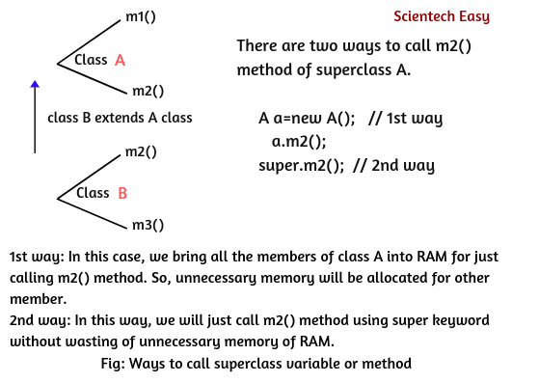
Java super keyword can be used in three ways: 1. To refer immediate parent class instance variable. 2. To call immediate parent class constructor. 3. To invoke immediate superclass method.
To call the superclass instance variable or method, we have two options
.

Slide 52
Using the super Keyword
Example:
//super keyword
class One{
int distance=50;
}
class SuperKeywordDemo extends One{
int distance=100;
void display()
{
System.out.println("distance is: "+super.distance);
System.out.println(this.distance);// Calling instance variable of the same class.
}
public static void main(String args[]){
SuperKeywordDemo obj=new SuperKeywordDemo();
obj.display();
//System.out.println(obj.distance);
}
}

Slide 53
Using the super Keyword
When invoking a super class version of an overridden method the super keyword is used.
Example:
class Demo extends ABC{
public void myMethod(){
//This will call the myMethod() of parent class
super.myMethod();
System.out.println("Overriding method from child class");
}
public static void main( String args[]) {
Demo obj = new Demo();
obj.myMethod();
}
}
Output:
Overridden method from parent class
Overriding method from child class
class ABC{
public void myMethod()
{
System.out.println("Overridden method from parent class");
}
}

Slide 54
Abstraction in Java
Abstraction is a process of hiding the implementation details and showing only functionality to the user.
Abstract class in Java
A class that is declared as abstract is known as abstract class. It needs to be extended and its method implemented. It cannot be instantiated. If a class contains any abstract method then the class is declared as abstract class.
Example abstract class
abstract class A{}

Slide 55

Real Life Example of Abstraction in Java
Abstraction shows only important things to the user and hides the internal details, for example, when we drive a car, we only know about how to drive car but can not know about how it work? And also we do not know the internal functionality of a car.

Slide 56
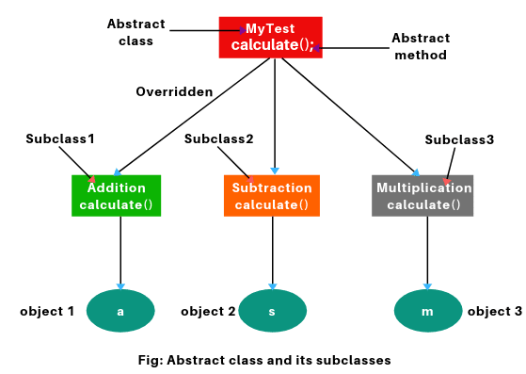
Abstraction in Java

Slide 57
Example of abstract class that has abstract method
abstract class Bike
{
abstract void run();
}
class Honda extends Bike
{
void run()
{
System.out.println("running safely..");
}
public static void main(String args[])
{
Bike obj = new Honda();
obj.run();
}
}

Slide 58
Example of abstract class that has abstract method
public abstract class MyTest
{
abstract void calculate(int a, int b); // No body.
}
public class Addition extends MyTest
{
void calculate(int a, int b)
{
int x = a + b;
System.out.println(“Sum: ” +x);
}
}
public class Subtraction extends MyTest
{
void calculate(int a, int b)
{
int y = a - b;
System.out.println(“Subtract: ” +y);
}
}
public class Multiplication extends MyTest
{
void calculate(int a, int b)
{
int z = a * b;
System.out.println(“Multiply: ” +z);
}
}
public class MyClass
{
public static void main(String[] args)
{
Addition a = new Addition();
Subtraction s = new Subtraction();
Multiplication m = new Multiplication();
a.calculate(20, 30);
s.calculate(10, 5);
m.calculate(10, 20);
}
}

Slide 59
final keyword:
The final keyword in java is used to restrict the user. The java final keyword can be used in many context. Final can be:
1. variable
2. method
3. class
Java final class
If any class is declared as final, then cannot extend it.

Slide 60
final keyword:
final keyword can be use with variables, methods and class.
=> final variables.
When we want to declare constant variable in java we use final keyword.
Syntax : final variable name = value;
=> final method
Syntax : final methodname(arg)
When we put final keyword before method than it becomes final method.
To prevent overriding of method final keyword is used, means final method cant be override.
=> final class
A class that can not be sub classed is called a final class.
This is archived in java using the keyword final as follow.
Syntax : final class class_name { ... }
Any attempt to inherit this class will cause an error and compiler will not allow it.

Slide 61
Example of final class
final class Bike
{}
class Honda extends Bike // compile time error ; try to extend final class Bike
{
void run()
{
System.out.println("running safely with 100kmph");
}
public static void main(String args[]){
Honda honda= new Honda();
honda.run();
}
}

Slide 62
Example of final class
final class aa
{
final int a=10;
public final void getData()
{
a++; // The final field aa.a cannot be assigned
}
}
class bb extends aa // The type bb cannot subclass the final class aa
{
public void getData() //Cannot override the final method from aa
{
System.out.println("a = " + a);
}
}
public class Final_Demo
{
public static void main(String[] args)
{
bb b1 = new bb();
b1.getData();
}
}

Slide 63
STRING HANDLING
The java.lang package contains two string classes: String and StringBuffer.
We can use the String class when you are working with strings that cannot change.
StringBuffer, on the other hand, is used when you want to manipulate the contents of the string on the fly.

Slide 64
STRING HANDLING
Creating Strings:
String greeting = "Hello world!";
The String class has eleven constructors that allow you to provide the initial value of the string using different sources, such as an array of characters:
public class StringDemo{
public static void main(String args[])
{
char[] helloArray = { 'h', 'e', 'l', 'l', 'o', '.'};
String helloString = new String(helloArray);
System.out.println( helloString );
} }

Slide 65
Java String class methods
The java.lang.String class provides many useful methods to perform operations on sequence of char values.
Length:
Methods used to obtain information about an object are known as accessor methods.
One accessor method that you can use with strings is the length() method, which returns the number of characters contained in the string object.
public class StringDemo{
public static void main(String args[]){
String palindrome = "Dot saw I was Tod";
int len = palindrome.length();
System.out.println( "String Length is : " + len ); }
}

Slide 66
Using + operator: HelloWorld Using concat method: HelloWorld
STRING HANDLING
Java String compareTo()
The java string compareTo() method compares the given string with current string lexicographically. It returns positive number, negative number or 0.
if s1 > s2, it returns positive number
if s1 < s2, it returns negative number
if s1 == s2, it returns 0

Slide 67
Example of java string compareTo() method
System.out.println(s1.compareTo(s2));//0 because both are equal
System.out.println(s1.compareTo(s3));//-5 because "h" is 5 times lower than "m"
System.out.println(s1.compareTo(s4));//-1 because "l" is 1 times lower than "m"
System.out.println(s1.compareTo(s5));//2 because "h" is 2 times greater than "f"
}}
public class CompareToExample{
public static void main(String args[]){
String s1="hello";
String s2="hello";
String s3="meklo";
String s4="hemlo";
String s5="flag";

Slide 68
Java String Methods
Java String length(): The Java String length() method tells the length of the string. It returns count of total number of characters present in the String.
Java String compareTo(): The Java String compareTo() method compares the given string with current string.
Java String concat() : The Java String concat() method combines a specific string at the end of another string and ultimately returns a combined string.
Java String IsEmpty() : This method checks whether the String contains anything or not. If the java String is Empty, it returns true else false.
String s1="";
String s2="hello";
System.out.println(s1.isEmpty()); // true
System.out.println(s2.isEmpty()); // false
Java String Trim() : The java string trim() method removes the leading and trailing spaces.
System.out.println(s1+"how are you"); // without trim() hello how are you
System.out.println(s1.trim()+"how are you"); // with trim() hellohow are you

Slide 69
Java StringBuffer class
Java StringBuffer class is used to create mutable (modifiable) string. The StringBuffer class in java is same as String class except it is mutable i.e. it can be changed.
Important Constructors of StringBuffer class
Constructor | Description
StringBuffer() | creates an empty string buffer with the initial capacity of 16.
StringBuffer(String str) | creates a string buffer with the specified string.
StringBuffer(int capacity) | creates an empty string buffer with the specified capacity as length.

Slide 70
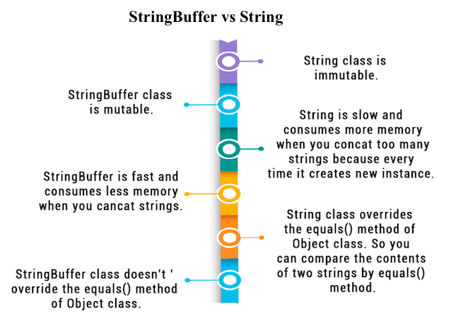
Difference between String and StringBuffer

